Slide 1
Smart Kitchen
Marco Pereira Da Silva - K2432045

Slide 2
Introduction
Today we’re presenting Smart Kitchen:
An app designed to stop good food from being thrown away simply because it gets forgotten.
Notes:
Today we’re presenting Smart Kitchen:
An app designed to stop good food from being thrown away simply because it gets forgotten.
We’ll open with a quick look at the scale of food waste globally and why households are one of the biggest contributors.

Slide 3

The Problem
What needs to change?
We often waste edible food because we lose track of what groceries we already have and when they expire. Ingredients get forgotten at the back of the fridge or duplicated during the next shop,
When it’s time to cook, people don’t have the time, ideas, or motivation to plan meals around what needs using first.
Notes:
THE PROBLEM
Households often waste edible food because they lose track of what groceries they already have and when those items will expire.
When it’s time to cook, people generally don’t have the time, ideas, or motivation to plan meals around what needs using first.
Existing approaches like mental notes, shopping lists rely on too much manual effort.
As a result, food goes out of date before it’s used, leading to avoidable waste, unnecessary spending, and frustration for people who want to eat more efficiently and sustainably.

Slide 4
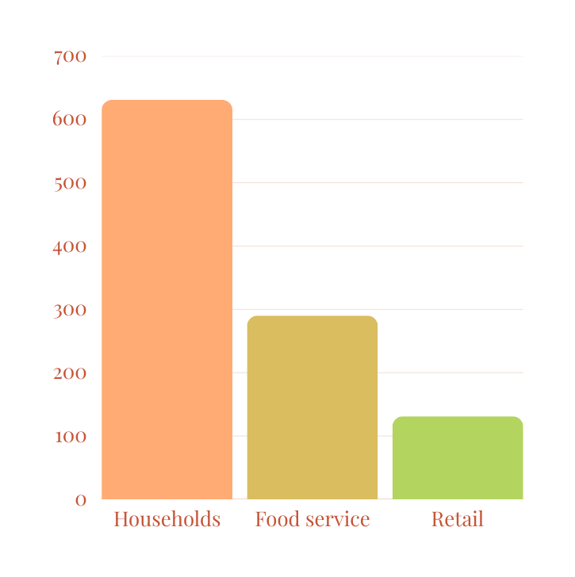
GLOBAL WASTE STATISTICS
1.05 billion tonnes of food were wasted in 2022 across households, food service, and retail (this includes inedible parts).
That’s about 132 kg per person per year, and roughly 19% of food available to consumers.
Where it happens (2022): 60% households, 28% food service, 12% retail.
Households alone: 631 million tonnes wasted in 2022 (about 79 kg per person per year).
Food loss and waste contributes about 8–10% of global greenhouse gas emissions.
United Nations Environment Programme (UNEP) (2024) Food Waste Index Report 2024: Think Eat Save: Tracking Progress to Halve Global Food Waste. Nairobi: UNEP. Available at: https://wedocs.unep.org/handle/20.500.11822/45230 (Accessed: 16 December 2025).

Slide 5
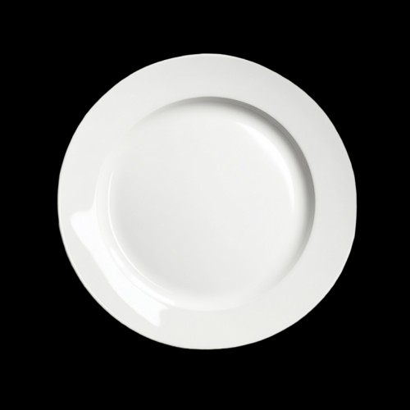
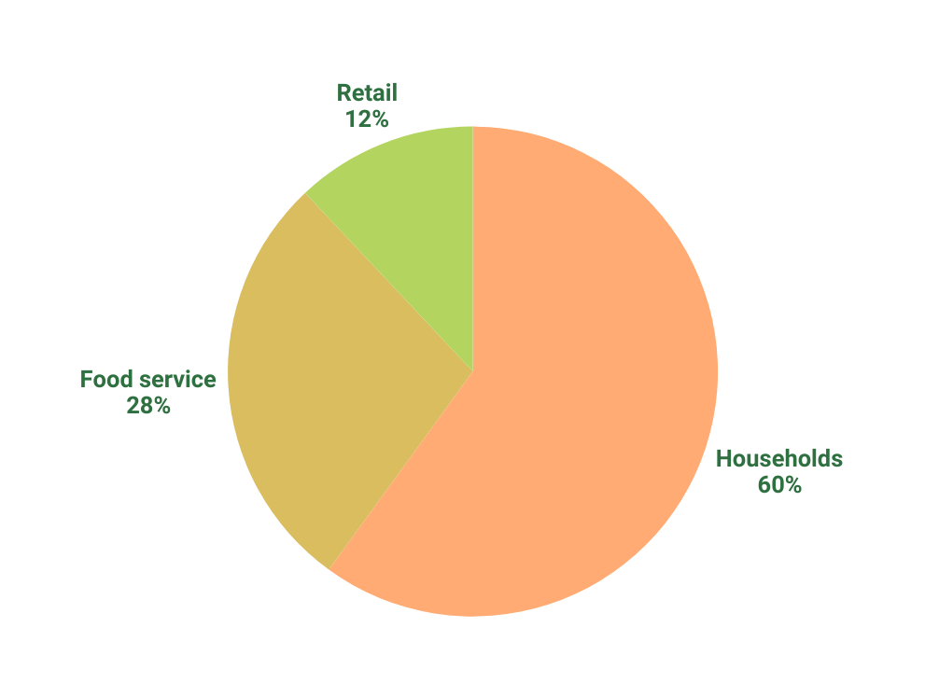
GLOBAL WASTE STATISTICS
1.05 billion tonnes of food were wasted in 2022 across households, food service, and retail (this includes inedible parts).
That’s about 132 kg per person per year, and roughly 19% of food available to consumers.
Where it happens (2022): 60% households, 28% food service, 12% retail.
Households alone: 631 million tonnes wasted in 2022 (about 79 kg per person per year).
Food loss and waste contributes about 8–10% of global greenhouse gas emissions.
United Nations Environment Programme (UNEP) (2024) Food Waste Index Report 2024: Think Eat Save: Tracking Progress to Halve Global Food Waste. Nairobi: UNEP. Available at: https://wedocs.unep.org/handle/20.500.11822/45230 (Accessed: 16 December 2025).

Slide 6





Why Now?
UK to halve food waste by 2030, and ensure healthy lives and well-being
Sustainability & growing eco-consciousness are a major trend
(UN SDG 12.3, 3)
Sustainability awareness
72% want to be more sustainable when shopping
58% plan to minimise household food waste within the next 12 months
People want to reduce waste, but don’t know how to,
this pressing problem creates a ripe market opportunity
45% Regularly use grocery apps in the UK
People need to make food last longer
Smart Kitchen
But only %38 take action
Cost-of-living
Digital readiness
Annual food inflation around 4.9% to 5.4%
Digital food related behaviour already present
Notes:
illustrated
1000 lost by each household, col 5%
behavioral, 72% 58%, 38%, intention
niche, 45%,
germany, food-r digihab
convergence, awareness, pressure, adoption, environment

Slide 7
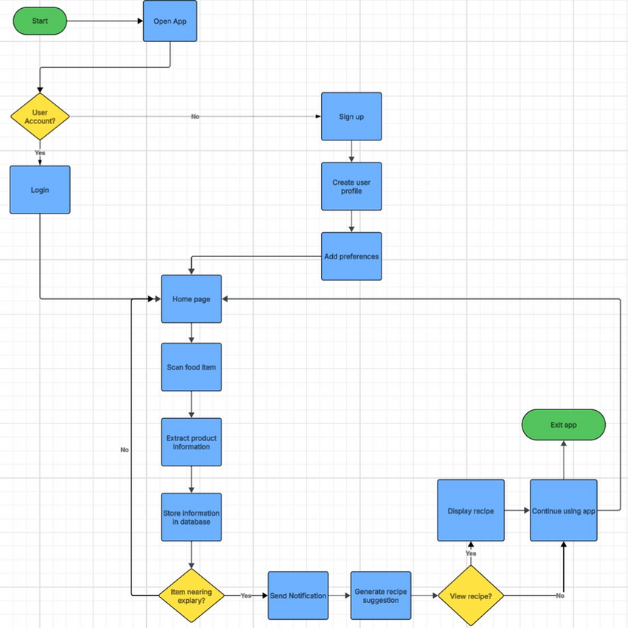



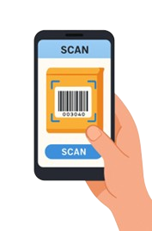

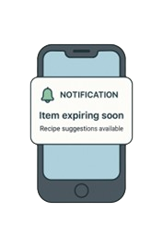
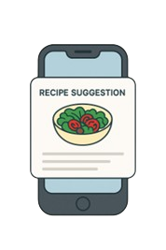
Solutions & Features
Food Management App/Service
Scan
Track
Notify
Enjoy
Smart food scanning using
Barcode API and AI-Powered OCR Text Recognition
Back-end Scheduler, automates tracking and notifications.
Reduces waste, costs and encourages sustainable habits.
AI Recipe Generator, saves time, simplifies meal planning and decision making.
Notes:
Solution​
Our solution to tackling household food waste is to create a food management app that would remind users when food items are about to expire and provide recipe suggestions accordingly. To achieve this, our application will include various features that will provide a reliable, intuitive, user-friendly experience.​
Scanning​
Starting with our smart-food scanning feature. Within the app, users will be able to access their live camera feed to scan each item when shopping. This scanning capability will utilize a barcode scanning API combined with AI-powered OCR text recognition to quickly detect and retrieve each items product information including the expiry date. By automating this process, it reduces the need for manual input from the user, saving time and frustration as commonly seen as a downfall from our competitors.​
Expiry Tracking and Notifications​
We will then use a backend scheduler to track each expiry date and trigger an automated push notification to the user reminding them when an item is about to expire. This ensures the user stays informed and organized, giving them enough time to use each item before they spoil, ultimately reducing waste, improving cost savings and encourage sustainable habits.​
​
Recipe suggestions ​
When the user is notified, they are also given the option to view recipe suggestions based on the expiring items. These recipes will be generated using an AI-powered recipe generator and will incorporate any dietary requirements or health goals that the user has setup within their user profile. This feature is beneficial as it not only supports nutritional guidance and personalization but also helps users save time by simplifying meal planning and decision making.​
​
User flow Diagram​
As you can see, we have also included a user flow diagram which shows the steps the user can take when using our app.

Slide 8


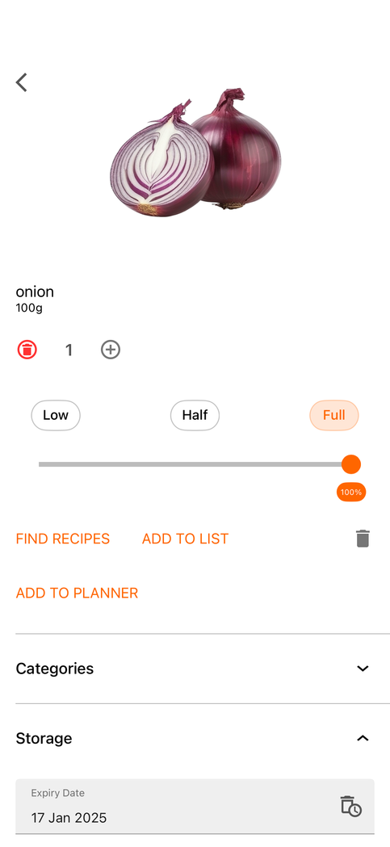
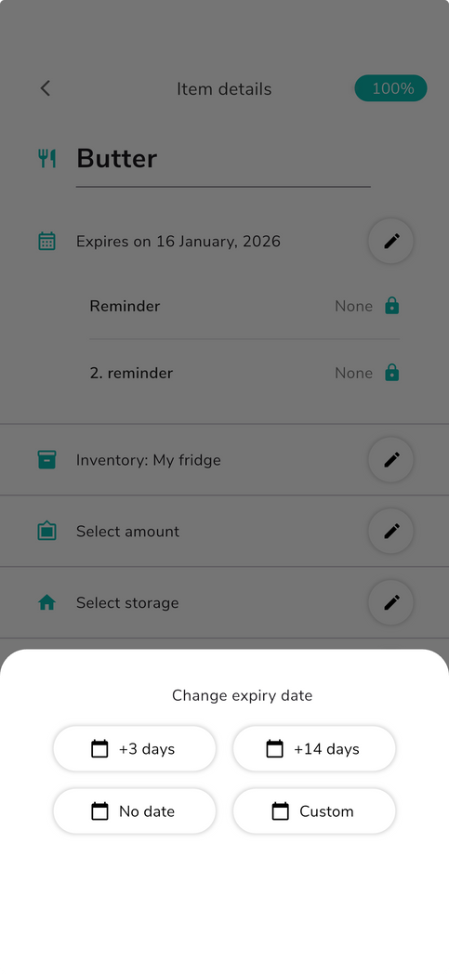
Our Competitive Advantage
Notes:
NoWaste and KitchenPal both attempt to target the same issue we’re solving.
NoWaste works like a digital pantry where users track what’s in their kitchen, and get reminders to use items in time.
KitchenPal is more of an all-in-one kitchen assistant, combining pantry tracking with scanning and recipe suggestions to support meal planning using what you already have.
Our competitive advantage is that we take that same foundation, but make it faster, smarter, and easier to rely on.
A big reason people stop using inventory apps is the effort of keeping them updated.
In our app, users can still manually add items when needed, but the main feature is barcode/photo scanning that automatically pulls the item details and fills in the expiry date with minimal effort.
We then go a step further with AI-generated recipes that are prioritised around what’s closest to expiring.
This is what sets us apart to our competition.

Slide 9


Value Proposition
Convenience
-Ease-of-use features (QR, OCR)
-We keep eyes on your products
-Gives a reminder when food spoils
Accuracy
-Food API database
-Nutritional info
-Expiry dates
Specification
-Suit dietary restrictions/medical conditions
-Recommends meal plans toward personal goals
Notes:
Smart Kitchen’s values can be simmered down into 3 general qualities;
Convenience, features like Optical Character Recognition and barcode scanning make nutrition and food management easier
Accuracy, access to a large comprehensive food database with accurate nutritional and expiry info
And Personalisation, adhering to any diet preference and food intolerance the user may have, may that be Keto, High fiber or exclude allergens (milk, gluten), Smart Kitchen will adjust accordingly

Slide 10
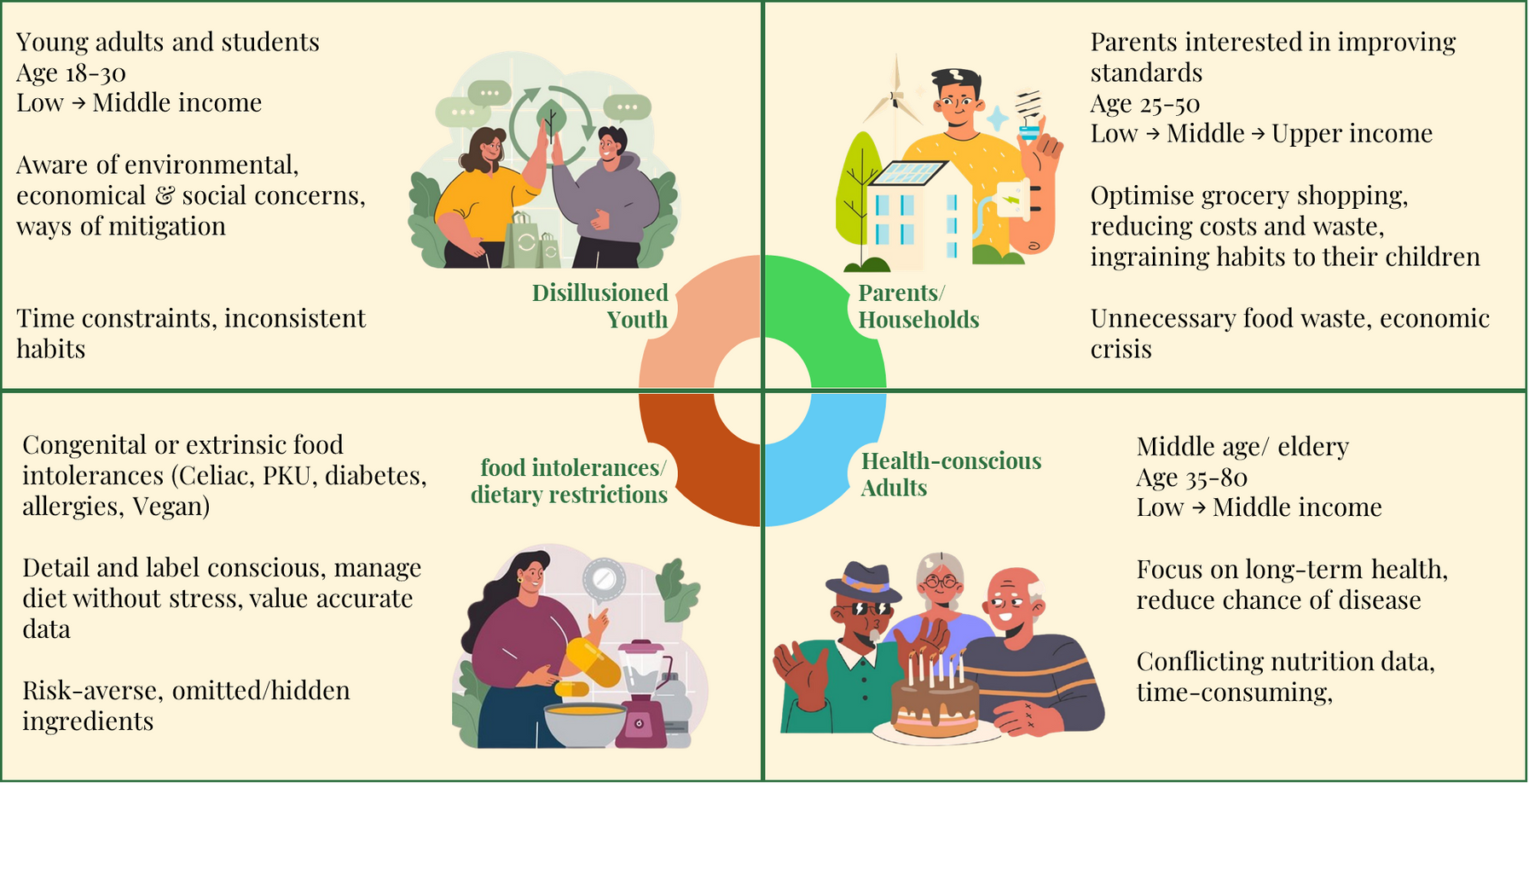
Demography
Notes:
Our demographic spans many groups and communities:
Young adults and students like ourselves aware of the pressure to need to be “green” , conscious of environmental issues
There are also new parents and families, aiming to improve living standards and teach their children those same ideals
Then the elderly, primarily focusing on their long-term health and reducing the chance of illnesses

Slide 11
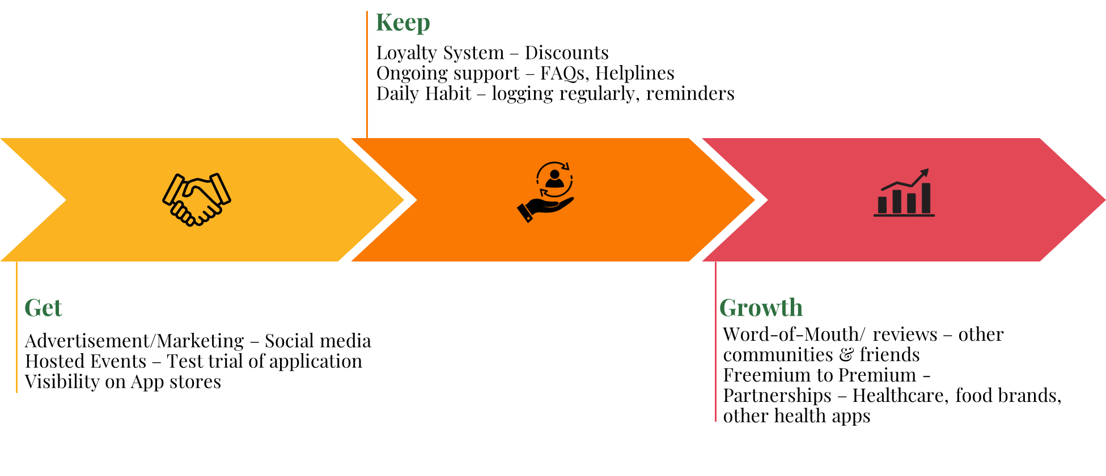
Customer Relationship
Aquisition & Retention
Notes:
Our customers, values and features has been detailed, now to focus on how we interact with our customers throughout the cycle of usage
Customer acquisition primarily happens from app stores and search engines, individuals searching key terms like food management, allergy safe and food tracking
But we will also have influencers and content creators referring viewers to try out our service
Aswell as host events in locations, such as supermarkets and farmer’s markets, which coincide with our service and allow the public to trial our app and its features,
Once users join, loyalty is built through a reward system, providing discounts and offers to use on groceries
retention is sustained by becoming a regular habit, relying on daily usage, user logging and reminders when food expires and our comprehensive food database ensures returning users
users satisfied with the service will leave positive reviews and recommend us to other communities and relatives,
Larger engagement may lead to partnerships, mainly healthcare providers, supermarkets and other health apps, namely integration with smart bands, watches and ring providers

Slide 12
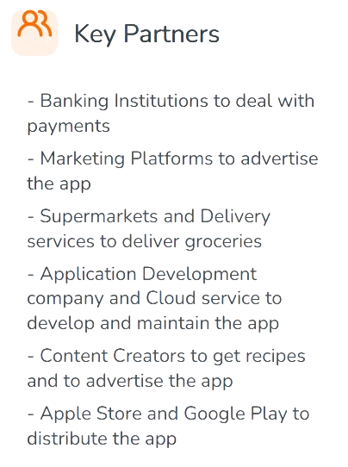


Operational Model
Business Model Canvas
- Marketing Platforms
- Content Creators
- Supermarkets
- Delivery Services
- Application Developers
- Cloud Services
- App Stores
- Banking Institutions
-Kickstarter and Crowdfunding
- Hire Services
- Design and Create
- Advertising
- Create and Maintain Partnerships
- Continuous Development
- Food API/ Database
- Mobile App
- User-generated Data
- Partners
- Development Team
- Artificial Intelligence

Slide 13
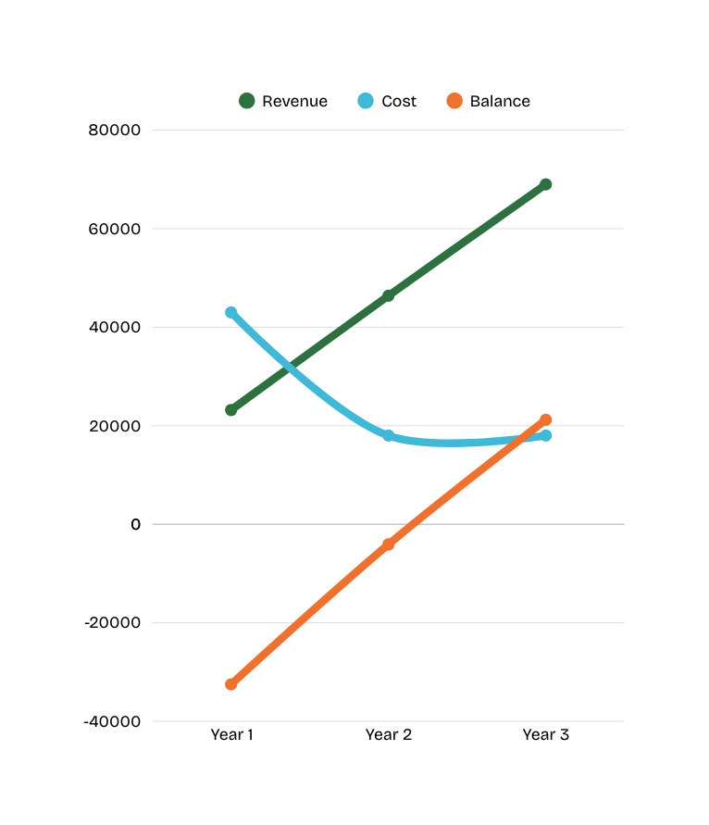


Financial Model
Business Model Canvas
- Initial Development: £25.000\one-off
- Maintenance: £10.000\yearly
- Cloud Services: £2.000\yearly
- Marketing: £3.000\yearly
- Partnerships: £2.000\yearly
- App Stores: £100\yearly
- Customer Support: £1.000\yearly
- Premium Subscription:
- 8% of total users
- 1000 user by month 12
- £3.99\month
Advertisement:
- ~15 per user, per month
- 50,000 for the year
- £4 for 1.000 views
Grocery Commissions:
- 3 – 5% of total users
- 6000 events by month 12
- 4 – 5% of basket value; ~£0.45

Slide 14
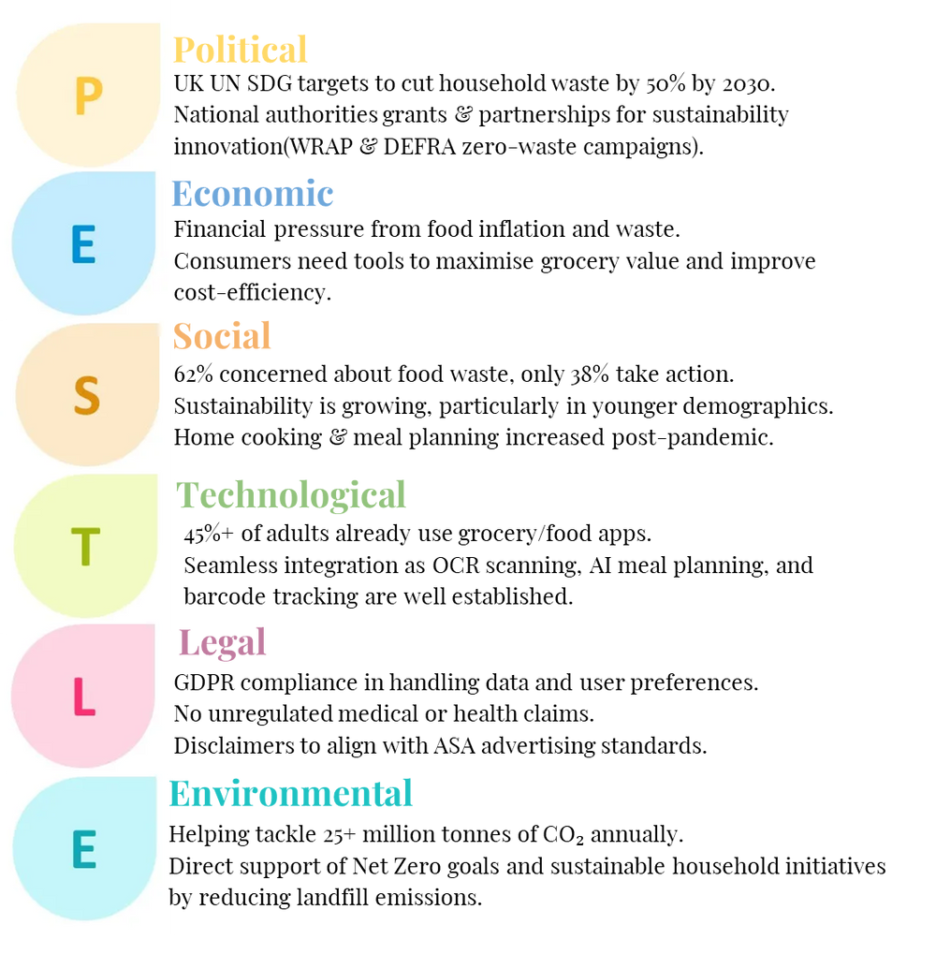
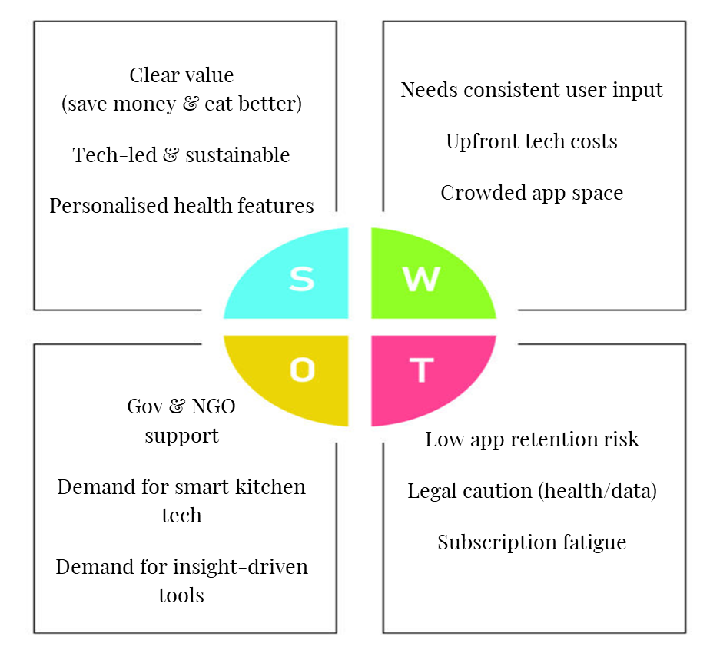
Analysis
PESTLE & SWOT
Notes:
evaluate
pol - un, halve, wrap
eco - help financially, 1000
soc - rising, healthier, automated ms&t, informed
tec - ocr, machine
leg - gdpr, asa
env - net zero, emissions
swot, market
value, save, eat
challenges, retention, dev, ecosys
grow institutional, tech, strategically lead

Slide 15

Scalability & Future Growth
AI Meal Planner & Smart Shopping List
Grocery Delivery Services
Allowing users to send their shopping list and past purchases straight to the supermarkets, saving time and effort.
Transforms our application from basic food tracking to an end-end food management platform whilst reducing food waste.
create tailored weekly meal plans, including dietary requirements, allergies and health goals.
Auto populated shopping list, include all ingredients from weekly meal plan
Notes:
Scalability​
As our application grows, it’s important to consider scalable features that will enhance user experience and handle increased growth and demand.​
​
AI meal planner and shopping list integration​
One feature we are considering is the integration of an AI-powered meal planner paired with an automated shopping list. Our app will provide users with a detailed weekly meal plan tailored towards their user profile and auto populate a shopping list based of the ingredients used within the plan, saving time and improving convenience.​
​
Grocery delivery Services ​
Another feature we have considered is the integration of grocery delivery services. This will allow users to send their automated shopping lists straight to large supermarkets saving time and effort. By partnering with large supermarkets, this feature would not only create additional value and revenue but transform our app from basic food tracking to an end-end food management platform whilst reducing food waste. ​

Slide 16
Conclusion
Notes:
In conclusion, we have identified a clear and well-evidenced problem, a defined target audience, and a solution with strong practical potential.
Our analysis shows clear demand in this market, while also revealing a key weakness in many existing approaches.
Overall, this project has a credible route to measurable impact in reducing avoidable food waste, lowering household costs, and supporting healthier everyday choices—while remaining scalable for future development.

Slide 17

Reflection
Notes:
Situation
When creating our initial business idea, we realised through market research and discussion that it was impractical. This left us behind schedule as we had to iterate back to the idea stage again.
Action
To overcome this, we set a deadline for everyone to do individual research on our idea and finalised our idea on a Teams call.
Result
We then assigned individual roles and tasks, and to ensure timely delivery we utilised the timebox method.
Reflection
Overcoming this challenge strengthened our team collaboration, responsibility, and communication abilities, and showed strong adaptability.
workload - evenly - underestimated - some - research
overcome - idea - business - step - structure - logically sections - assign - equally - overlap
confident - understanding - done - deadlines - targets.
organisation - logical ps - peer

